Slide 1

RUNGTA COLLEGE OF DENTAL SCIENCES & RESEARCH
TITLE OF THE TOPIC-
CLEFT LIP AND PALATE
DEPARTMENT OF ORTHODONTICS AND DENTOFACIAL ORTHOPAEDICS

Slide 2
Specific learning Objectives
CORE AREAS | DOMAIN | CATEGORY
INTRODUCTION | AFFECTIVE | DESIRE TO KNOW
INCIDENCE | AFFECTIVE | DESIRE TO KNOW
EMBRYOLOGY | COGNITIVE | NICE TO KNOW
ETIOLOGY | COGNITIVE | MUST KNOW
CLASSIFICATION | PSYCHOMOTOR | MUST KNOW
PROBLEM | COGNITIVE | MUST KNOW
MANAGEMENT | PSYCHOMOTOR | NICE TO KNOW

Slide 3
CONTENTS
PART I
Introduction
Incidence
Embryology
Etiology & Predisposing factors
Classifications
PART II
Classifications
Problems associated with clefts
Management
Summary

Slide 4
Classification by Fogh Anderson 1942-
Group1: they are cleft of the lip divided into:
-Single-unilateral or median cleft
-Double-bilateral cleft
Group2:they are the cleft of the lip and then palate divided into:
-Single-unilateral cleft
-Double-bilateral cleft.
Group3-they are cleft of the palate extending upto the incisive foramen.

Slide 5
Schuchardt and Pfelfer’s symbolic classification-
This classification makes use of a chart made up of a vertical block of three pairs of rectangles with an inverted triangle at the bottom. The inverted triangle represents the soft palate while the rectangle represents the lips, alveolus and the hard palate as we go down. Areas affected by cleft are shaded on the chart. The advantage of this classification is its simplicity while the disadvantage include difficulty in wiring, typing & communication.

Slide 6
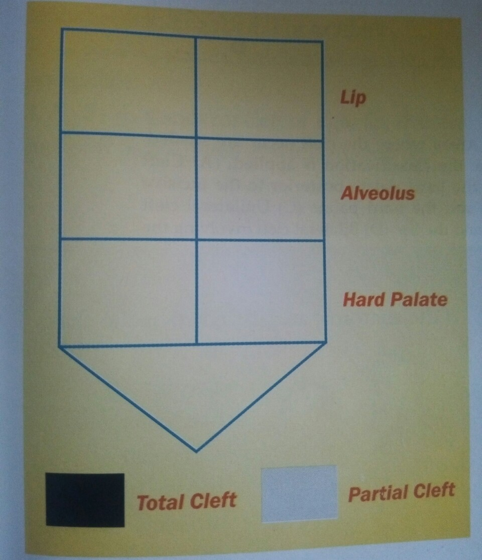
Schuchardt and Pfeifer’s symbolic classification

Slide 7
Kernahan’s stripped ‘Y’ classification-
This is another symbolic classification put forward by Kernahan and Stark.
The classification uses a stripped ‘Y’ having numbered block. Each block represents a specific area of the oral cavity.
Block 1 and 4 – Lip
Block 2 and 5 – Alveolus
Block 3 and 6 – Hard palate anterior to the incisive foramen
Block 7 and 8 – Hard palate posterior to incisive foramen
Block 9 – Soft plate.

Slide 8
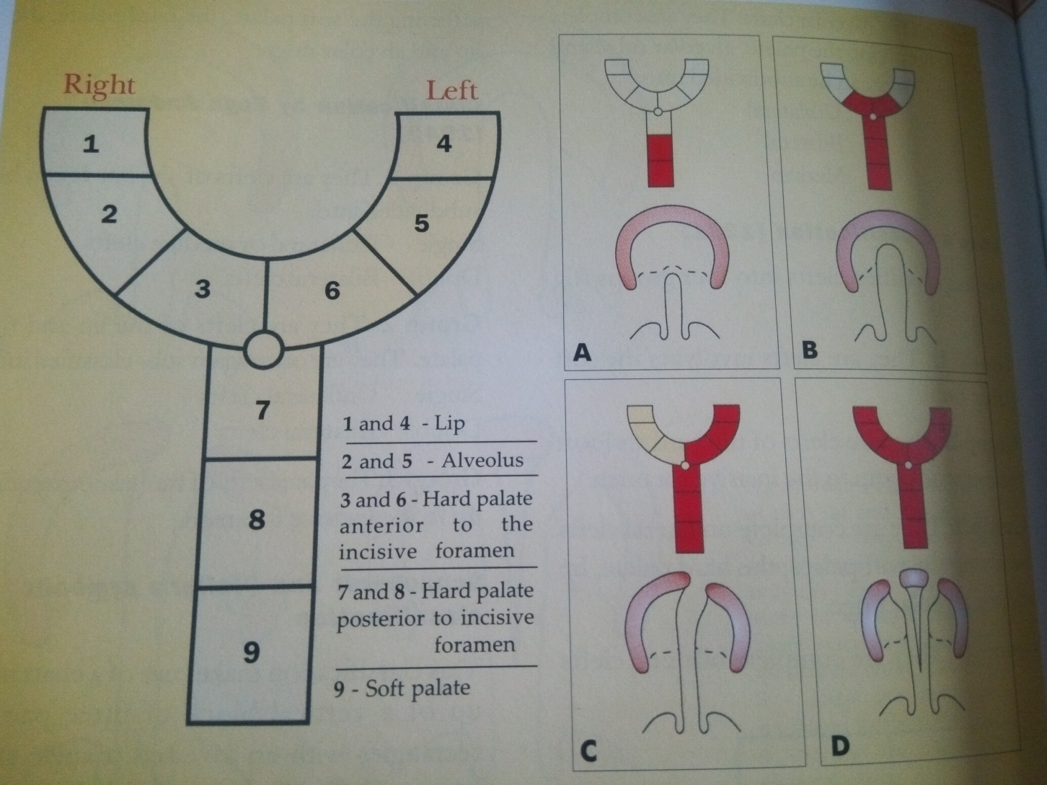
Kernahan’s stripped Y classification

Slide 9
Lahshal classification-
This is a simple classification presented by Okriens in 1987. LAHSHAL is a paraphrase of the anatomic areas affected by the cleft.
L – Lip
A – Alveolus
H – Hard palate
S – Soft palate
H – Hard palate
A – Alveolus
L – Lip the classification is based on the fact that cleft of lip, alveolus and hard palate can be bilateral while cleft involving the soft palate are usually . Areas involved in the cleft are denoted by specifically indicating the alphabet standing fot it.
For example, L—S--- stands for cleft of right lip and soft plate.
LA-S—L stands for cleft of right lip, alveolus, and soft palate together with left cleft lip.

Slide 10
PROBLEMS ASSOCIATED WITH CLEFTS.
Dental.
Esthetic.
Speech and Hearing.
Psychologic.

Slide 11
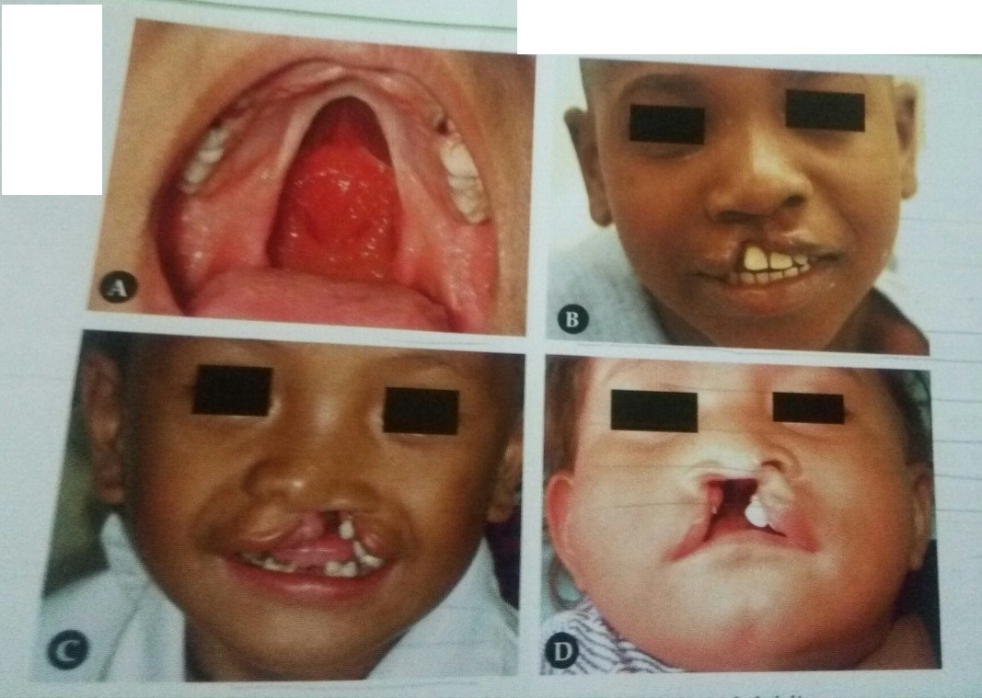
a. Cleft of the hard and soft plate, B.unilateral cleft lip, C.&D.unilateral cleft of the lip and palate

Slide 12
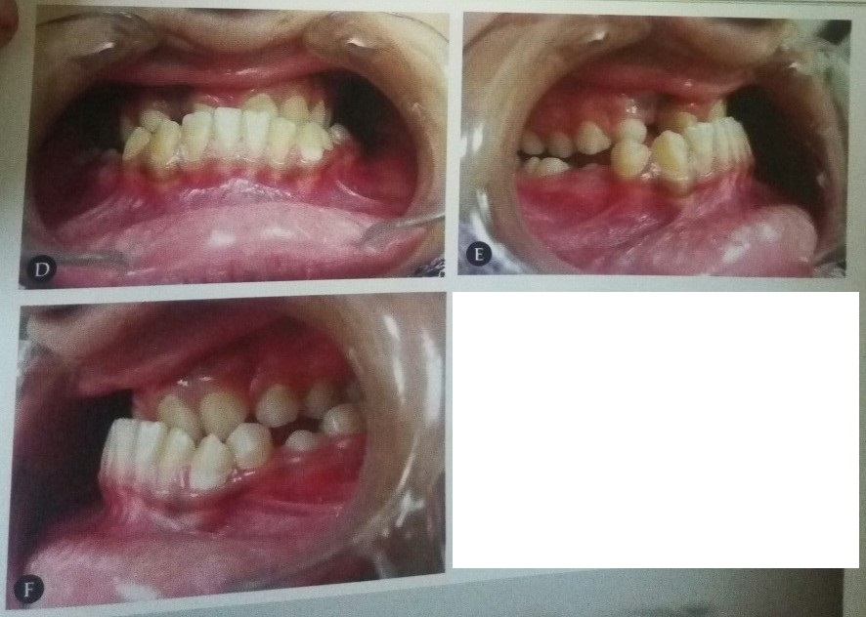
A.&B.pateint with unilateral cleft of the lip and palate. Note the absence of some ant. Teeth & related malocclusion

Slide 13
DENTAL PROBLEMS-
-Congenitally missing teeth(most commonly the upper laterals)
-Presence of natal or neonatal teeth.
-Presence Supernumerary teeth.
-Ectopically errupting teeth.
-Anomalies of tooth morphology.
-Enamel Hyperplasia.
-Microdontia.
-Fused teeth.
-Macrodontia
-Mobile and early shedding of teeth due to poor periodontal support.
-Protruding Pre-Maxilla.
-Deep bite, Spacing/Crowding.

Slide 14
ESTHETIC PROBLEMS-
-The cleft involving the lip can result in facial disfigurement varying from mild to severe.
-The orofacial structres may be malformed and congenitally missing.Deformities of nose can occur.Thus esthetics is greatly affected.

Slide 15
MANAGEMENT OF CLEFT AND PALATE.
-Children born with cleft lip and palate have a number of problems that have to be solved for sucessful rehablitation. The complexity of the problem require that a number of health care practioners cooperate to ensure comprehensive care of patient.
STAGE1:
-This comprises of the treatment done from birth to 18months of age.

Slide 16
STAGE2:
-This is from the 18th month to the 5th year of life.It generally corresponds to the primary dentition stage.
STAGE3:
-This includes treatment that is carried out during the mixed dentition stage.It spans from 6th to 11th year of life.
STAGE4:
-This includes treatment done during the permanent dentition stage that is 12 to 18 years of age.

Slide 17
STAGE 1 TREATMENT.
The treatment modalties carried out during the first stage includes:
-Fabrication of passive obturator.
-Pre surgical orthopaedics.
-Surgical management of cleft lip.
-Surgical management of cleft palate.

Slide 18
PASSIVE MAXILLARY OBTURATOR:
-The maxillary obturator is an intra oral prosthetic device that fills the palatal cleft and thus provides a false roofing against which the child can suckle.
PRESURGICAL ORTHOPAEDICS:
-The aim of pre surgical orthopaedic is to achieve an upper arch form that conforms to the lower arch.The absece of variable amount of lip tissue and the division in the alveolus and palate results in outward displacement of pre maxilla.

Slide 19
SURGICAL LIP CLOSURE:
SURGICAL PLATE CLOSURE:
-The palatal repair should be attempted between 12 to 24 months.This facilitates normal speech ,hearing and improves swallowing.The palatal repair can be accompolished by using bone transplant that are taken from rib,iliac bone,mandibular symphysis,tibial bone or outer table of parietal bone.

Slide 20
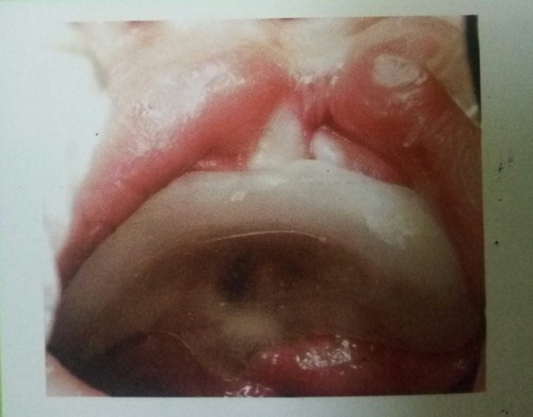
Passive maxillary obturator

Slide 21
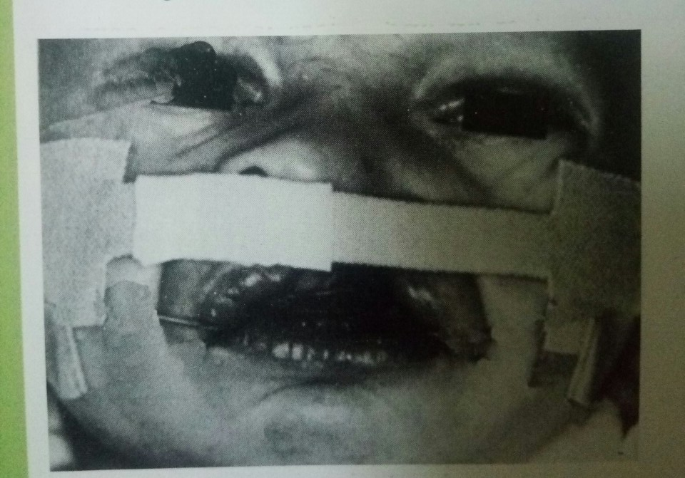
Pre-surgical orthopaedics by extraoral strapping across the premaxilla

Slide 22
STAGE 2 TREATMENT.
This comprises of the treatment carried out during the primary dentition:
Adjustment of the intraoral obturator to accommodate the erupting deciduous teeth.
To maintain a check on eruption pattern and timing.
Oral hygiene instructions.
Restoration of decayed teeth.

Slide 23
STAGE 3 TREATMENT.
Stage 3 includes treatment carried out during the mixed dentition phase. As in the early years, the main emphasis through out the mixed dentition stage should be on the prevention of dental diseases.
SECONDARY ALVEOLAR BONE GRAFTING:
-Secondary alveolar bone grafting in patient with cleft lip and palate is now a common practice at the stage of mixed dentition.

Slide 24
●The main benefit of secondary alveolar bone grafting are:
-It provides a firm bony support for the alar base to minimize nasal deformity.
-Elimination of oronasal and nasolabial fistula, hence avoiding nasal reflux of fluid and air.
-Stablization of maxillary segments.
-Facilitation of teeth eruption into the cleft site and achieve orthodontic movement adjacent to the cleft site.

Slide 25
The orthodontic procedure usually carried out during the mixed dentition phase are:
-Correction of anterior cross bite using removable or fixed appliances.The anterior cross bite should be corrected to avoid functional mandibualr displacements.
-Buccal segment crossbites are also treated using quad helix or expansion screws.

Slide 26
STAGE 4 TREATMENT.
This stage consists of treatment during the permanent dentition.The presence of the permanent dentition usually heralds the start of definitive orthodontic treatment. Patient with a cleft lip and palate often undergoes a long course of appliance therapy, sometimes in conjunction with orthognathic surgery to correct the jaw relationship.
Most cleft lip and palate patient require long term if not permanent retention for the following reason:
Inadequate bone support.
Absence of some teeth.
Presence of stretched scar tissue.

Slide 27
SUMMARY
Cleft lip and palate are congenital abnormalities that affect the upper lip and the hard and soft palate of the mouth.
Three main types occur morphologically: 1. Cleft lip (CL) 2. Cleft lip and palate (CLP) 3. Isolated cleft palate (CP).
The patient is afflicted by a number of problems associated with the functions performed by the oral and nasal cavities.
Children born with cleft lip and palate have a number of problems that have to be solved for successful rehabilitation.
The complexity of the problem requires that a number of specialists get together at various stages of development for the eventual betterment of the patient.

Slide 28
REFERENCES
Textbook of Orthodontics – Gurkeerat Singh, Jaypee Brothers; 2nd Edition
Orthodontics – The Art and Science, S.I Bhalajhi, AryaMedi Publishing; 7th Edition
Textbook of Orthodontics – Sridhar Premkumar, Elsevier; 1st Edition
Orthodontics: Diagnosis and Management of Malocclusion and Dentofacial Deformities – O.P Kharbanda, Elsevier; 1st Edition

Slide 29
Question & Answer Session

